Slide 1
Rapid Pass Program
January 2024
Notes:
Title Slide Instructions:
Title: Arial Bold, 28pt.
Subtitle/Presenter Name: Arial Regular, 22pt.

Slide 2
Start Saving Today
What is Rapid Pass
Apple and Android compatible
Preferred pricing at The Home Depot
Up to 25% off select items with no minimum purchase required
All purchases count towards ProXtra account
Rapid Pass allows:
1 Process
1 Pricing Structure
2,000+ locations
Notes:
Transition Slide Instructions:
This slide is to be used in between presentations to signify the start of a new topic or presenter.
Section Title: Arial Bold, 28 pt.
Subtitle: Arial Regular, 22 pt.

Slide 3
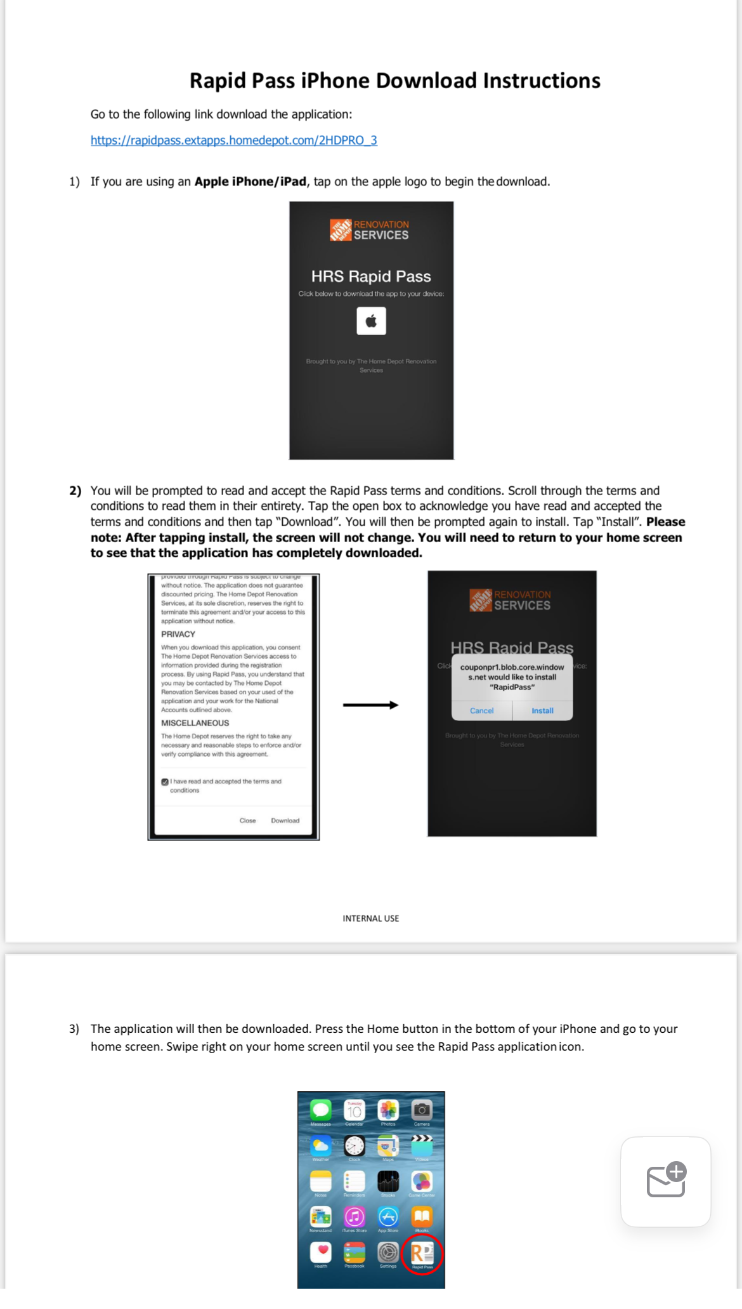
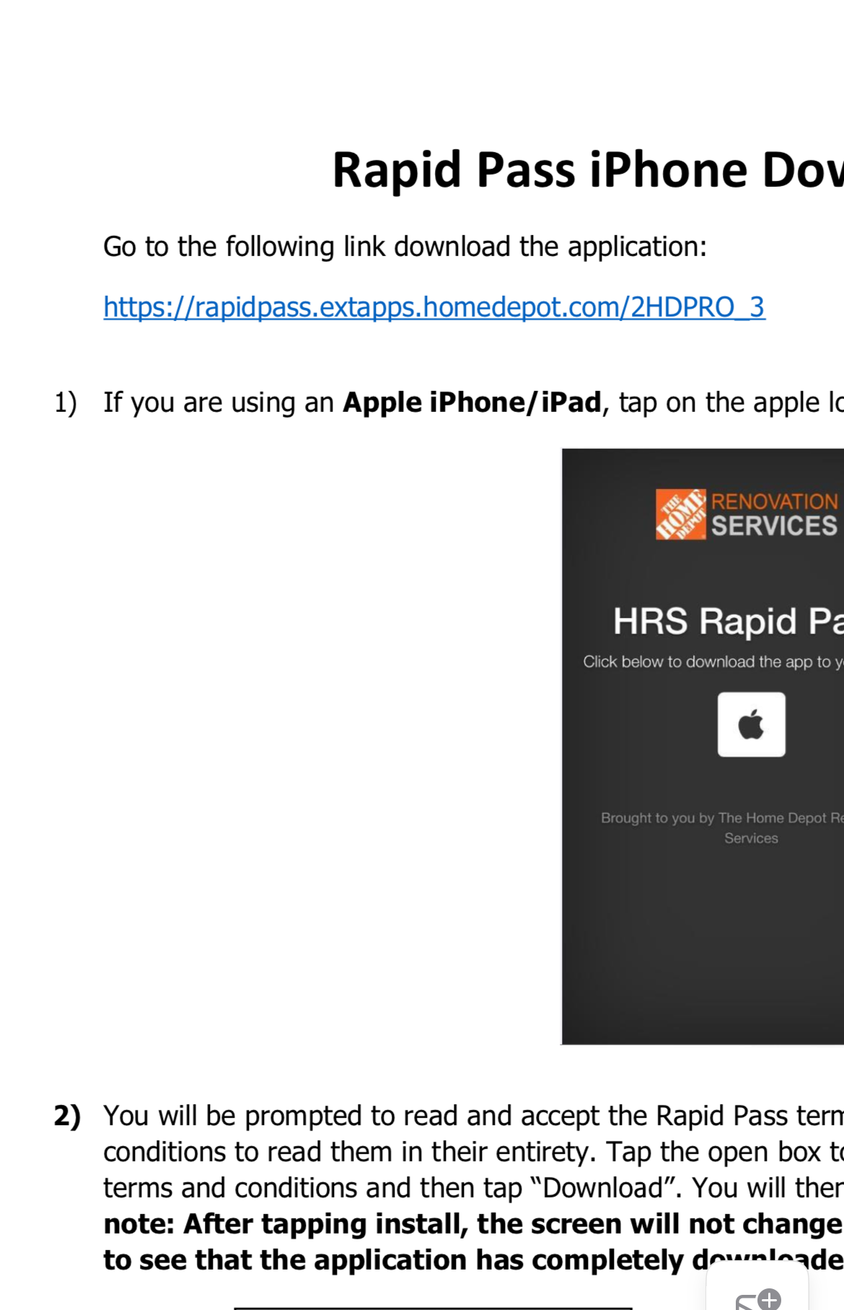
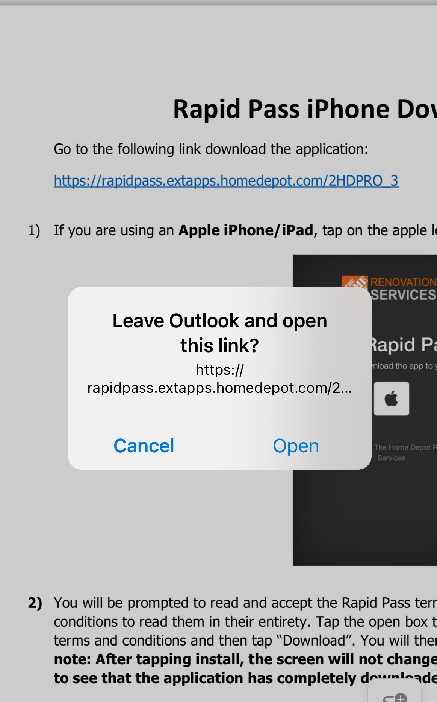
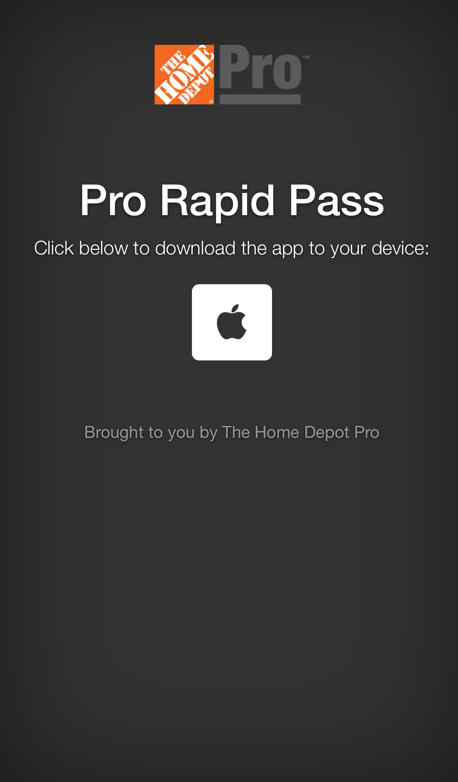
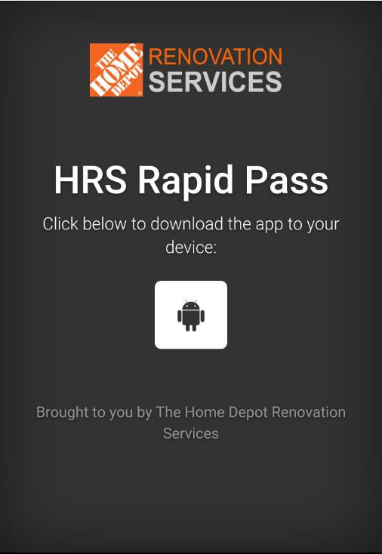
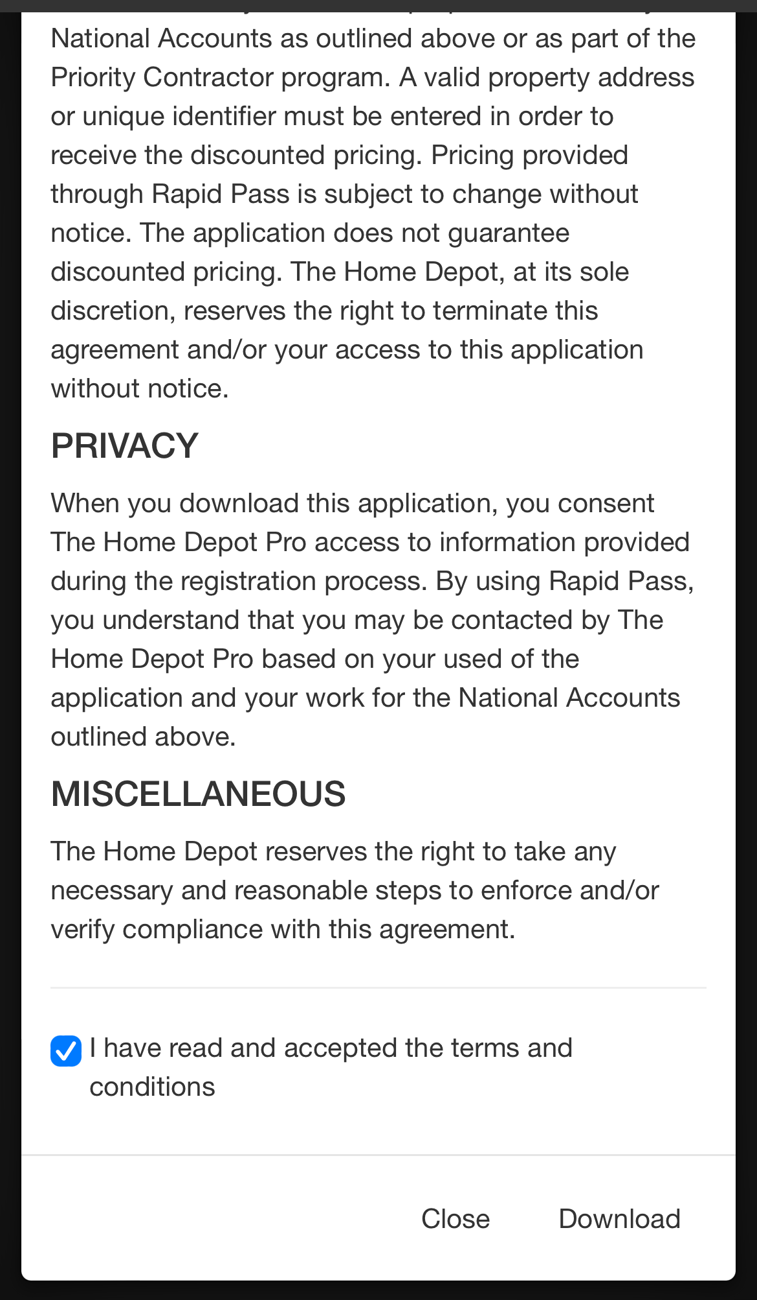
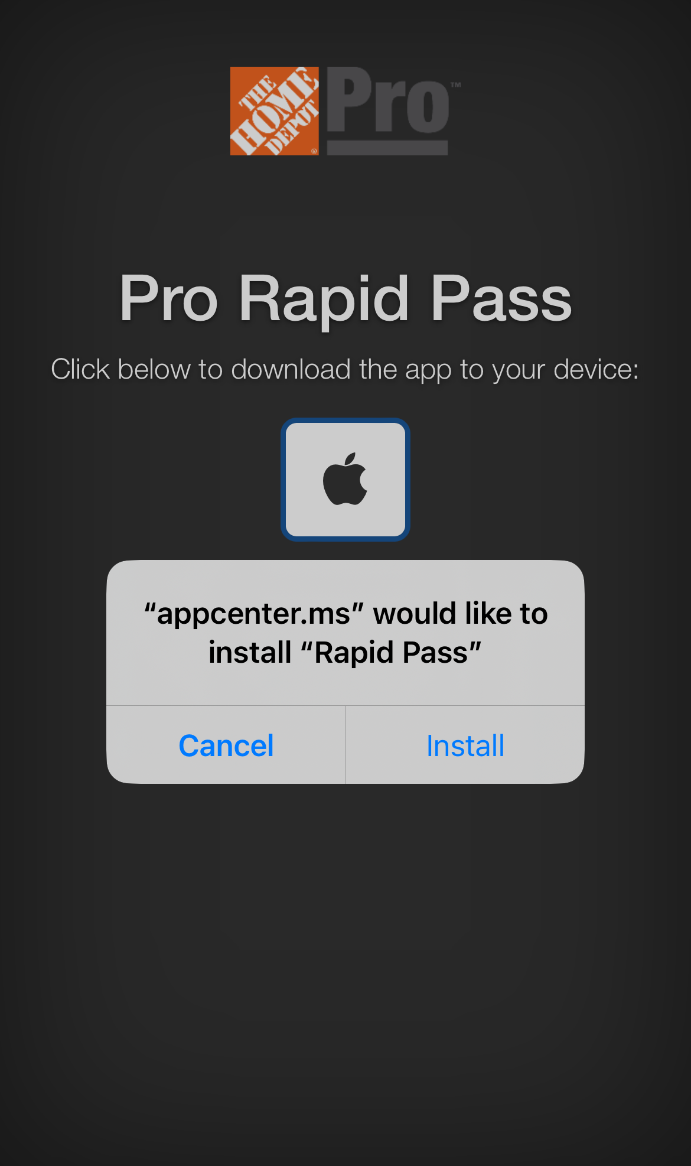
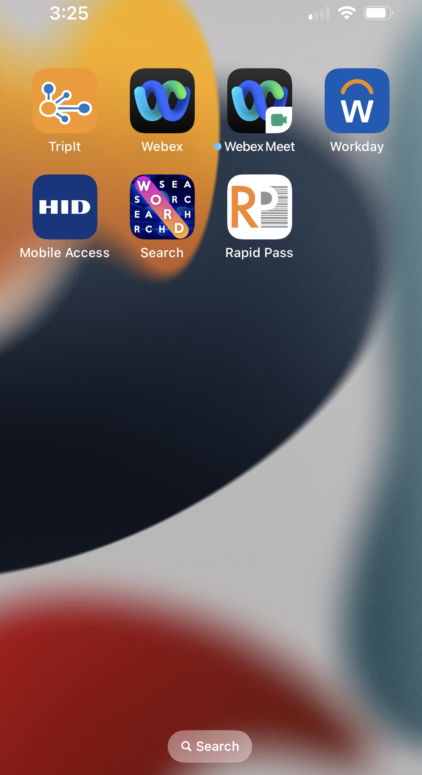
Installing & Downloading Rapid Pass
Open and Install **IOS and ANDR mobile devices will have appropriate logo; Click the logo to Download: If incorrect OS link was sent, please notify your National Account for correct OS.
Open the PDF Link on your mobile
device. This will be sent by National Account
Click the link to open Installation Process
Open the link on a mobile device only
Continue to Download, Install and Rapid Pass App should be visible on your mobile device; Next page is Registration
**If Rapid Pass is being installed on a
new device or for the initial download,
you may need to “Trust” the app
within your device's settings before Install will complete.
Rapid Pass can be installed on 3 devices per email address
For Iphones: For Android:
Go to Settings During Install, if blocked,
General Go to Settings
Device Management Security
Select The Home Depot Select Unknown Sources
Trust the Application App will Install
Install should proceed Open

Slide 4
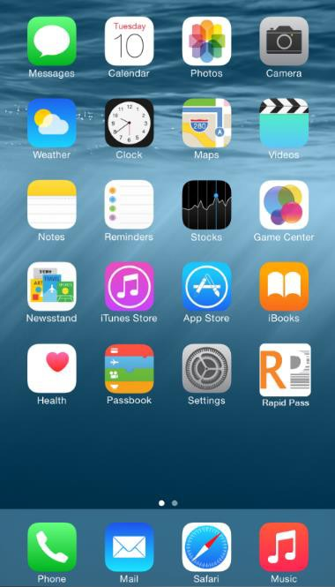
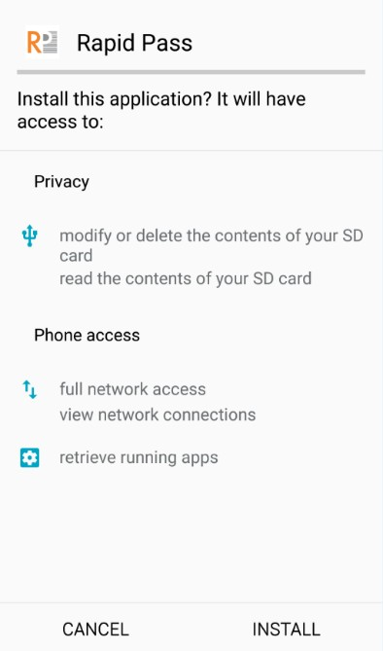
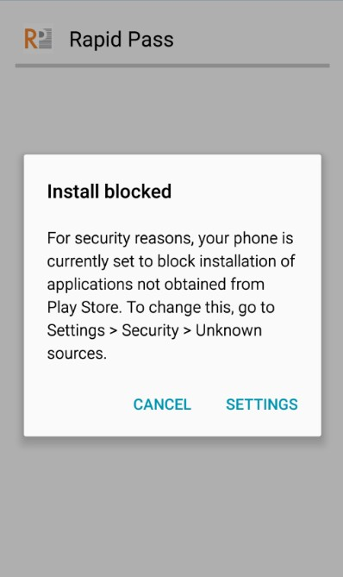
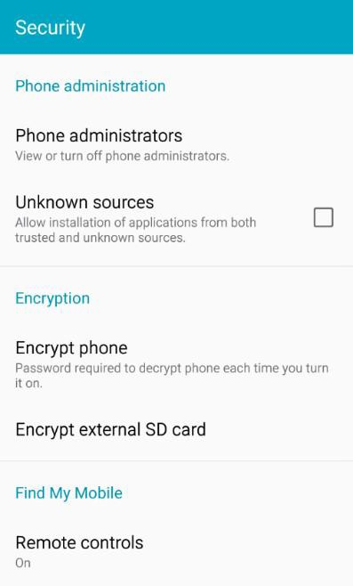
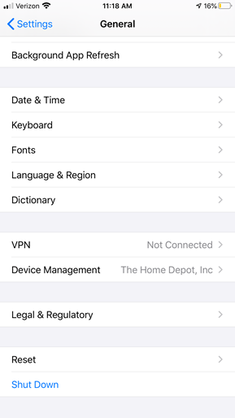
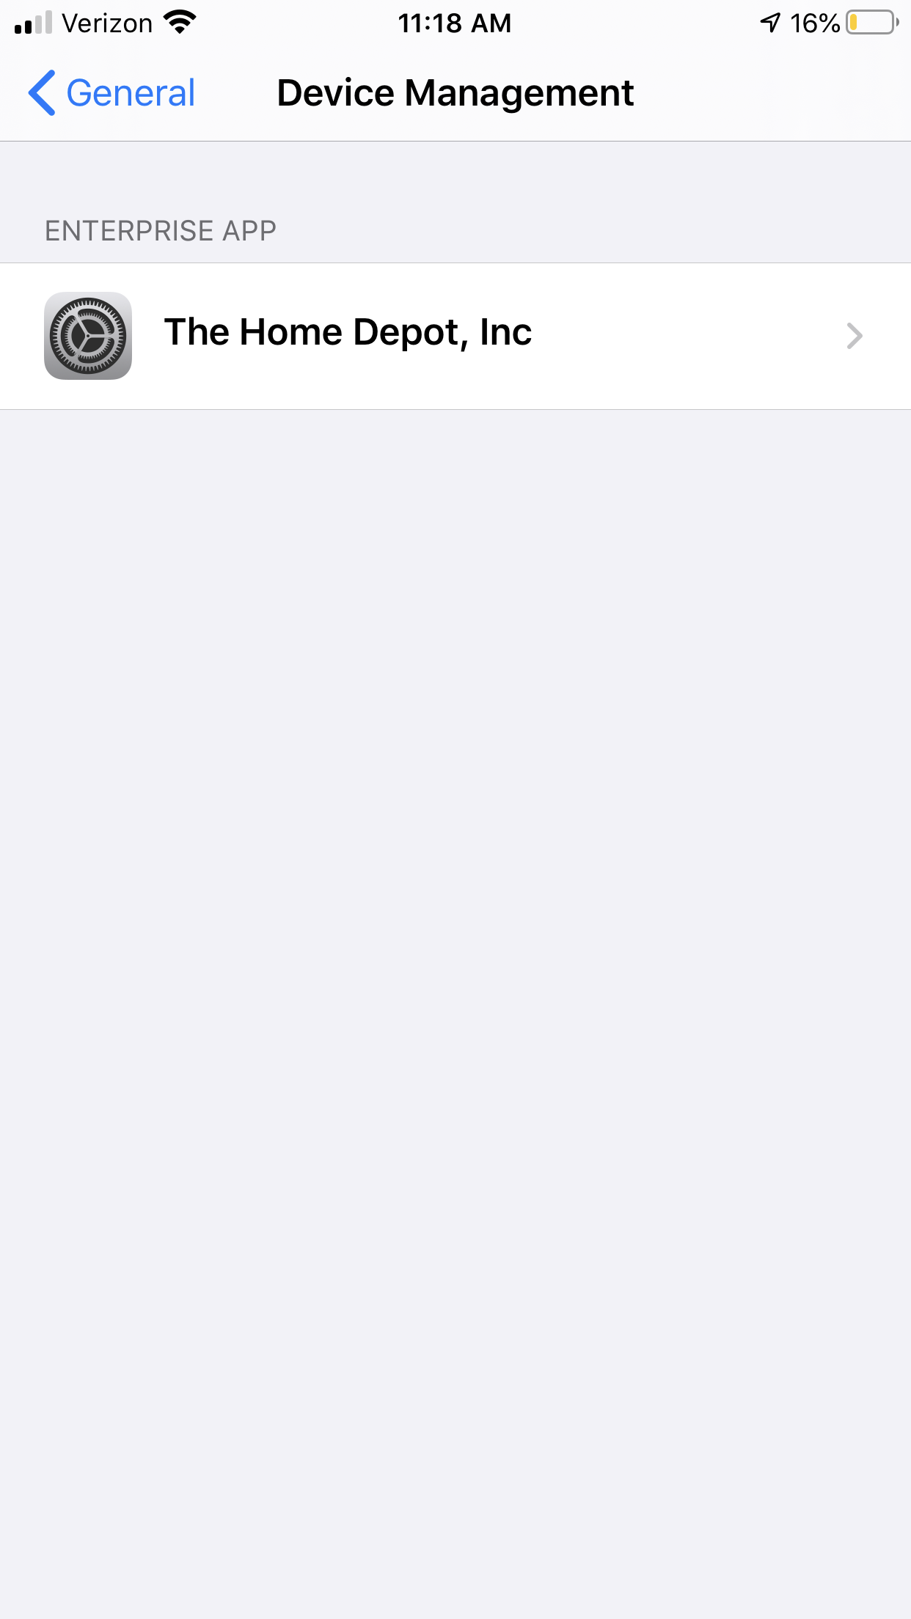
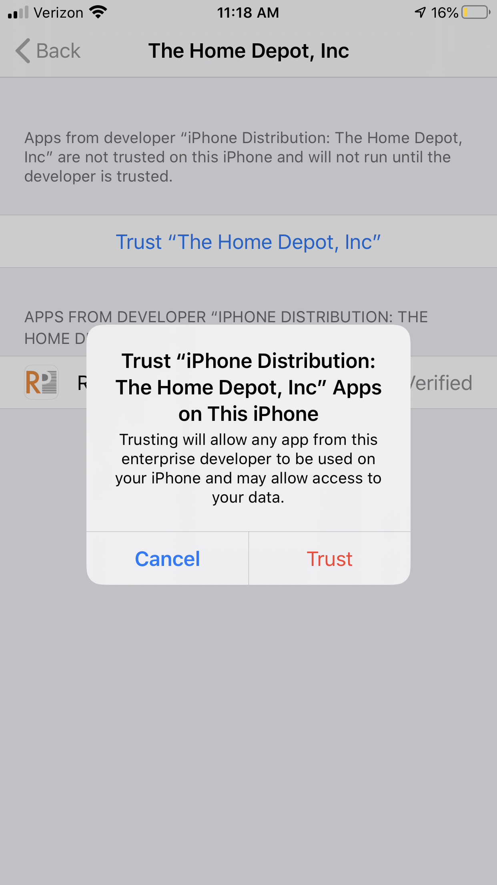
Rapid Pass: How to Trust on IOS & Install unknown source on Android:
iPhones
Androids

Slide 5
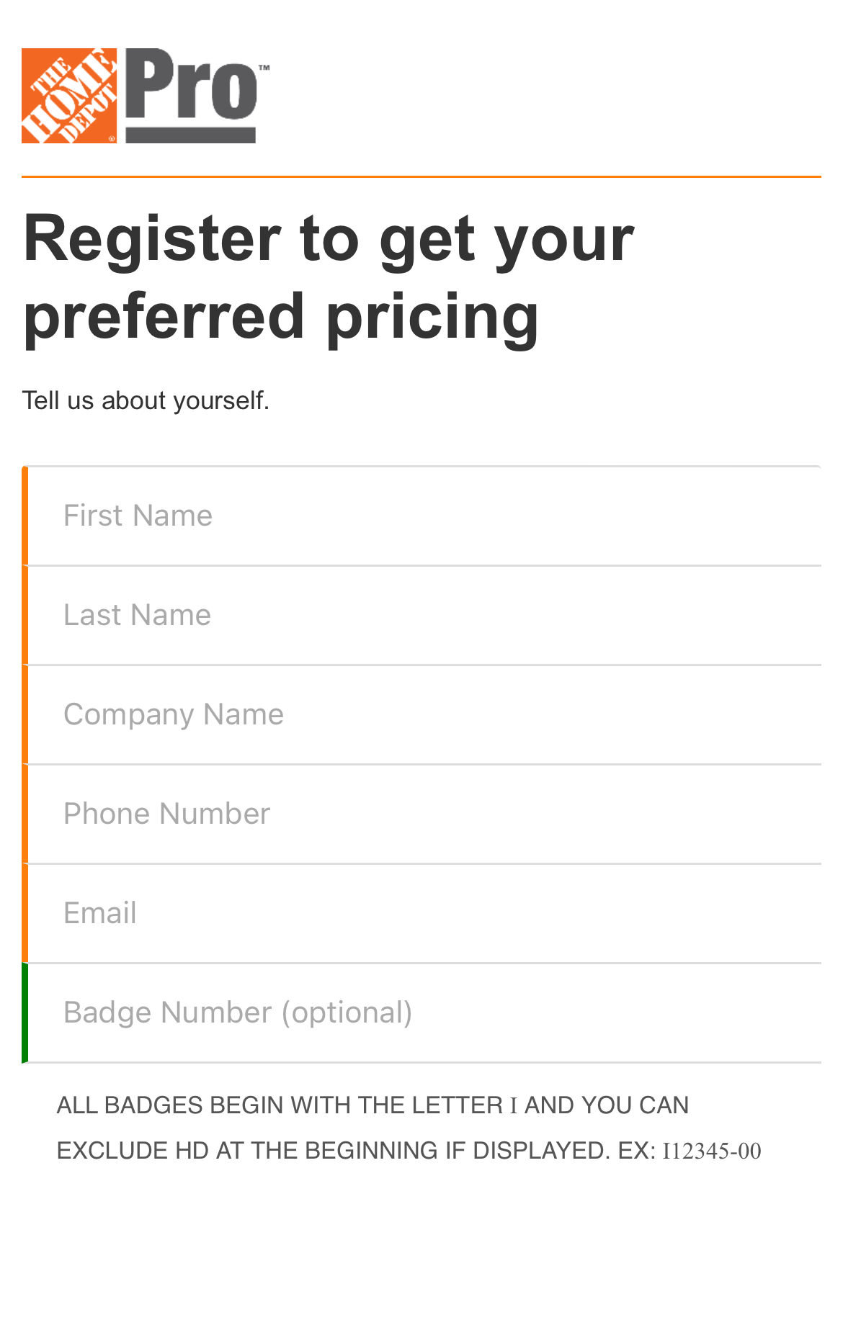
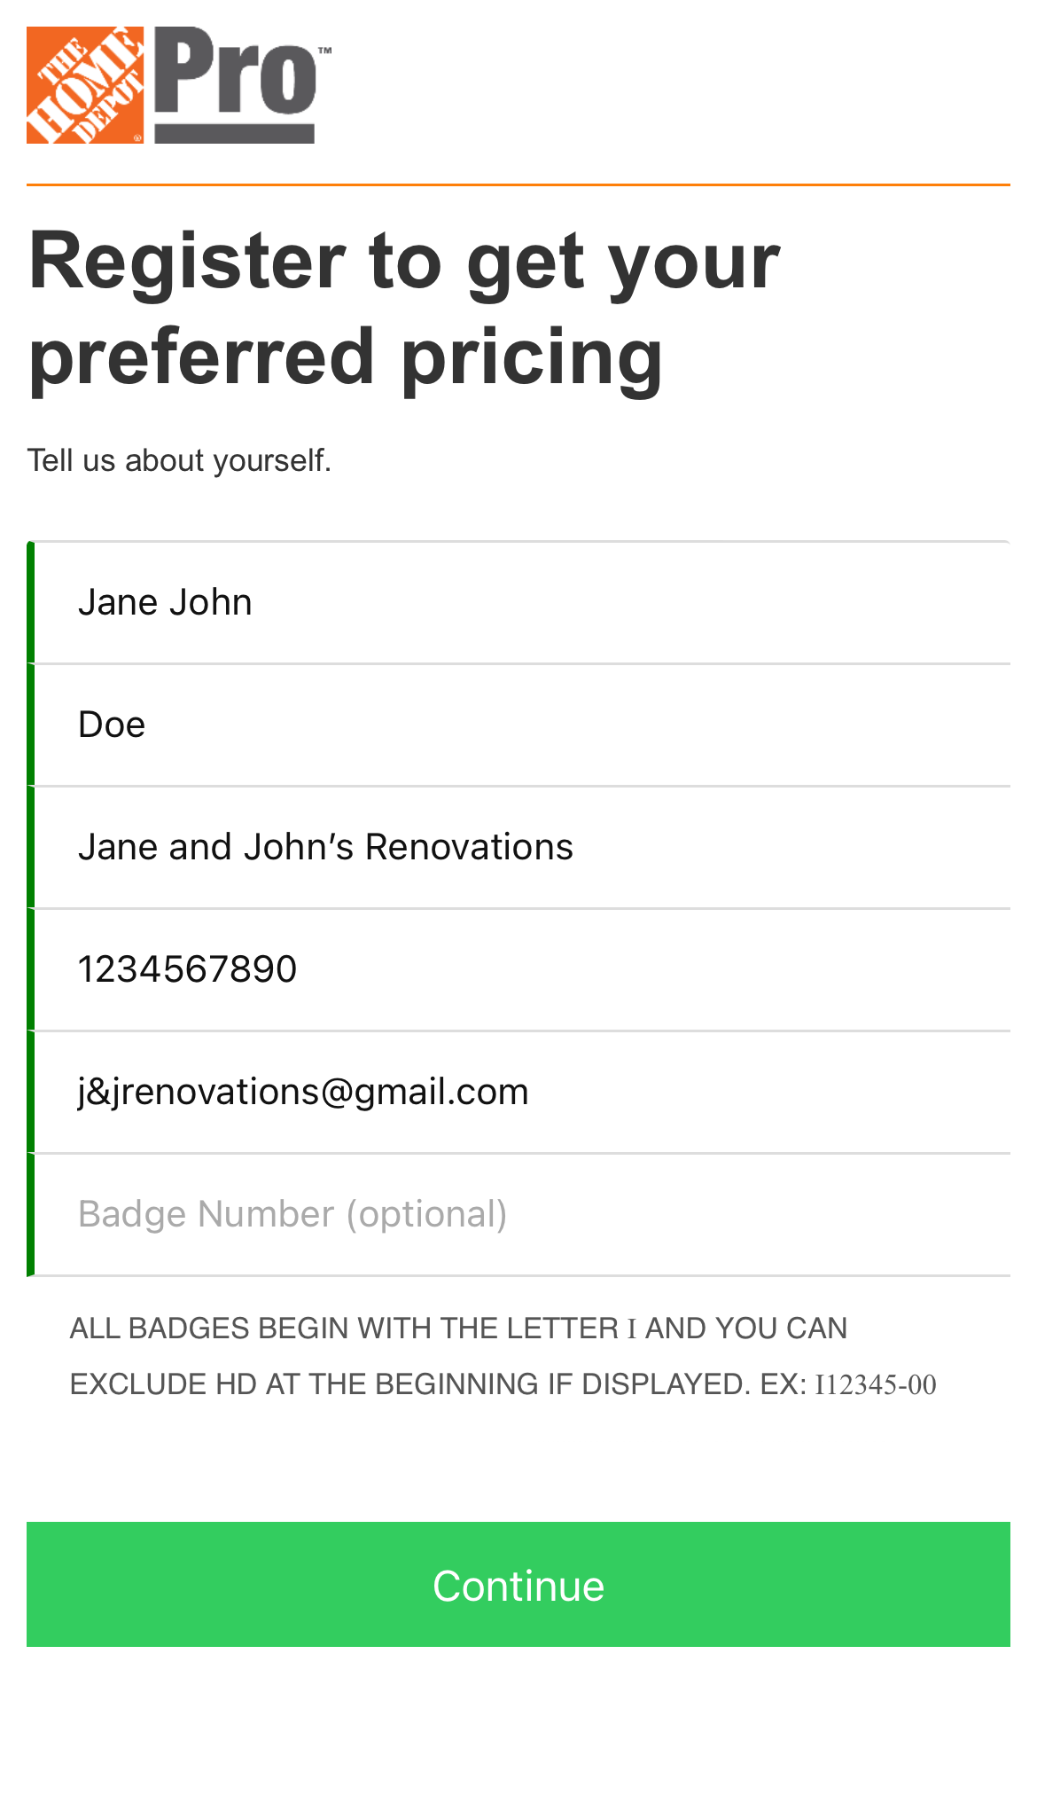
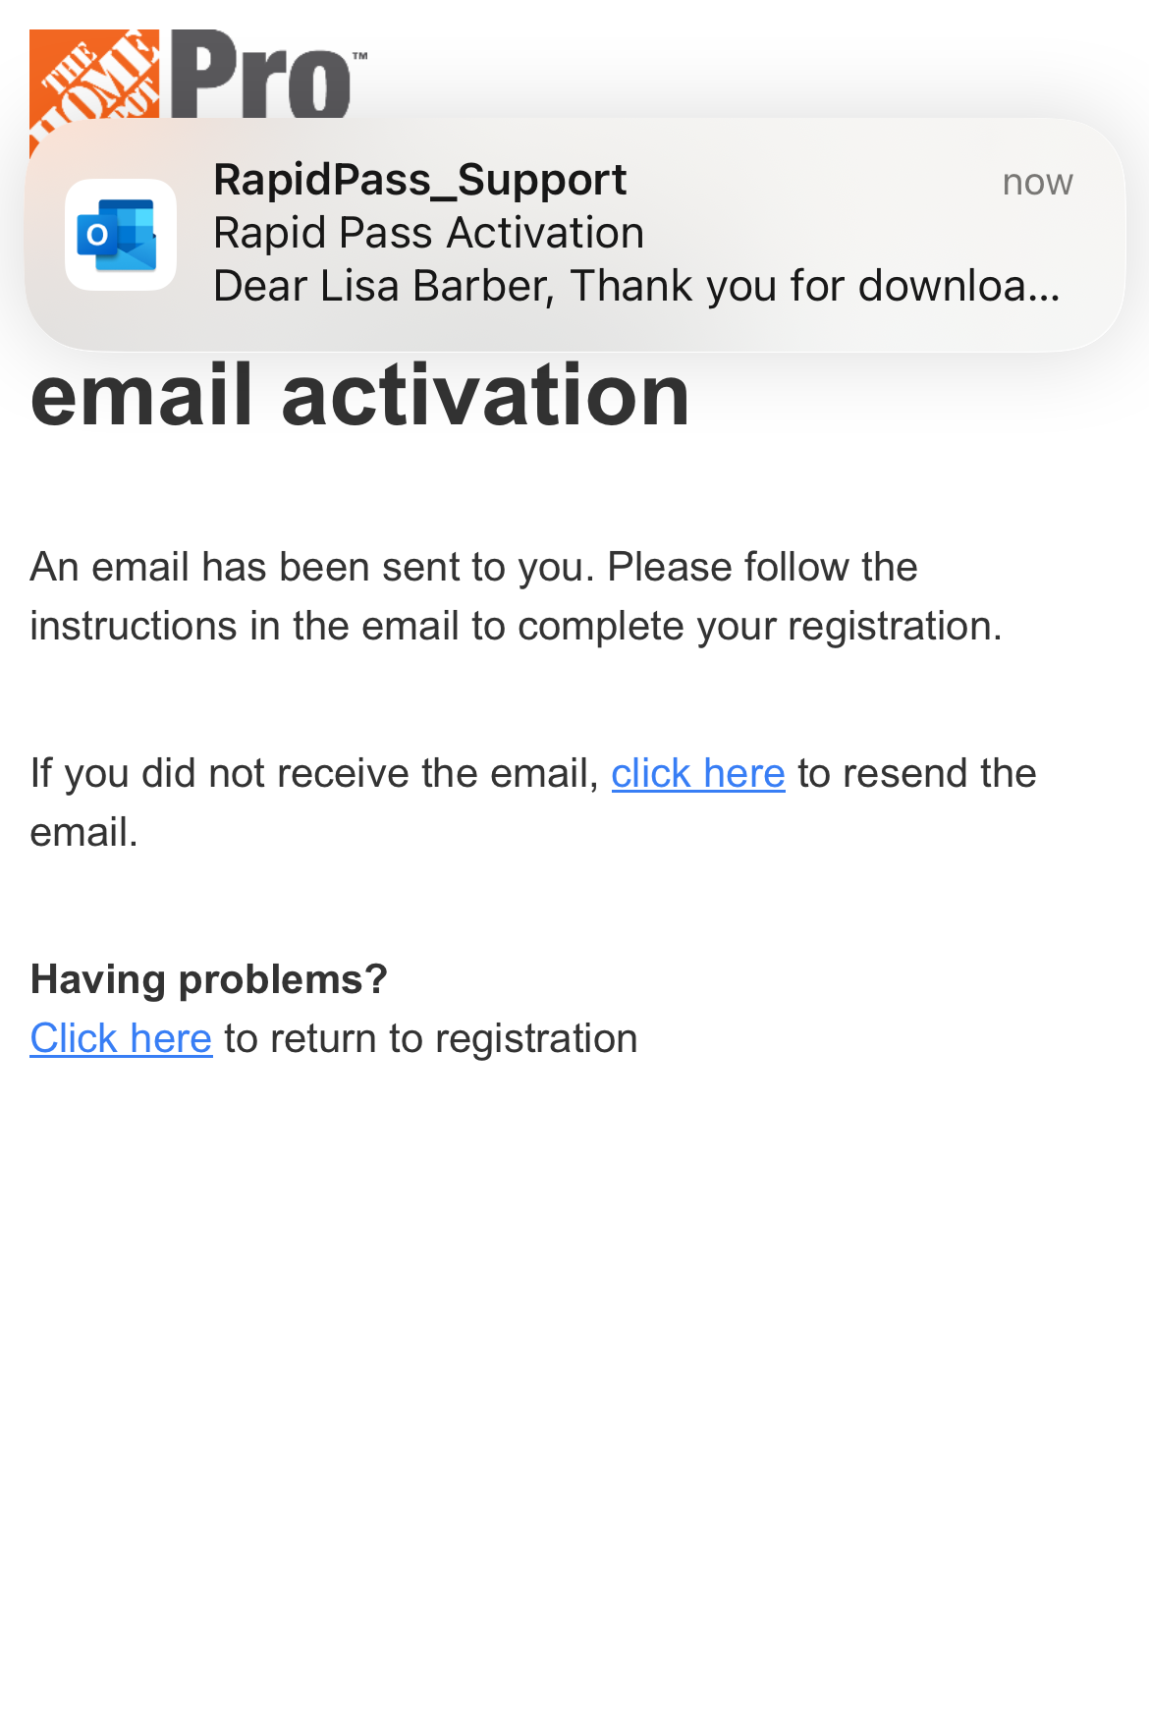
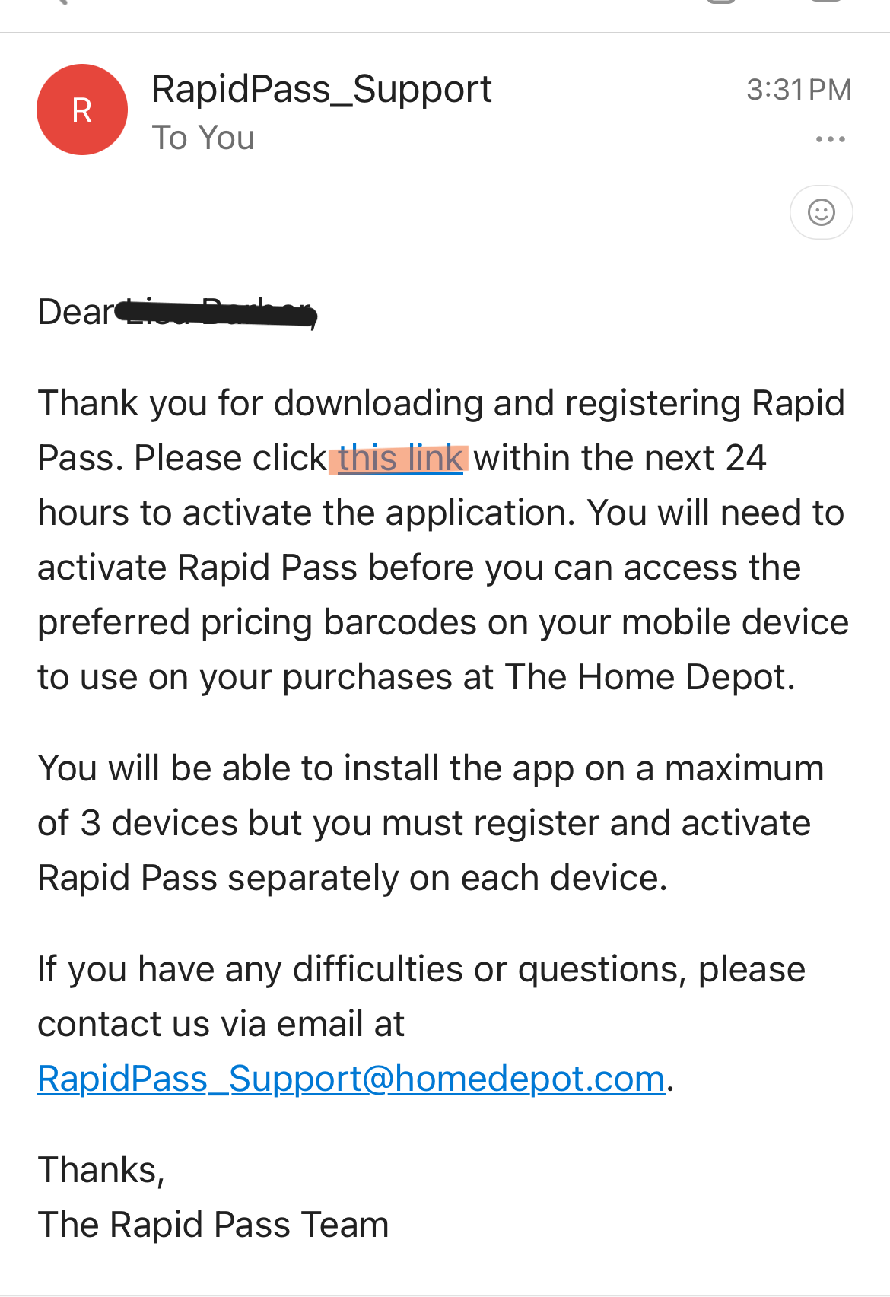
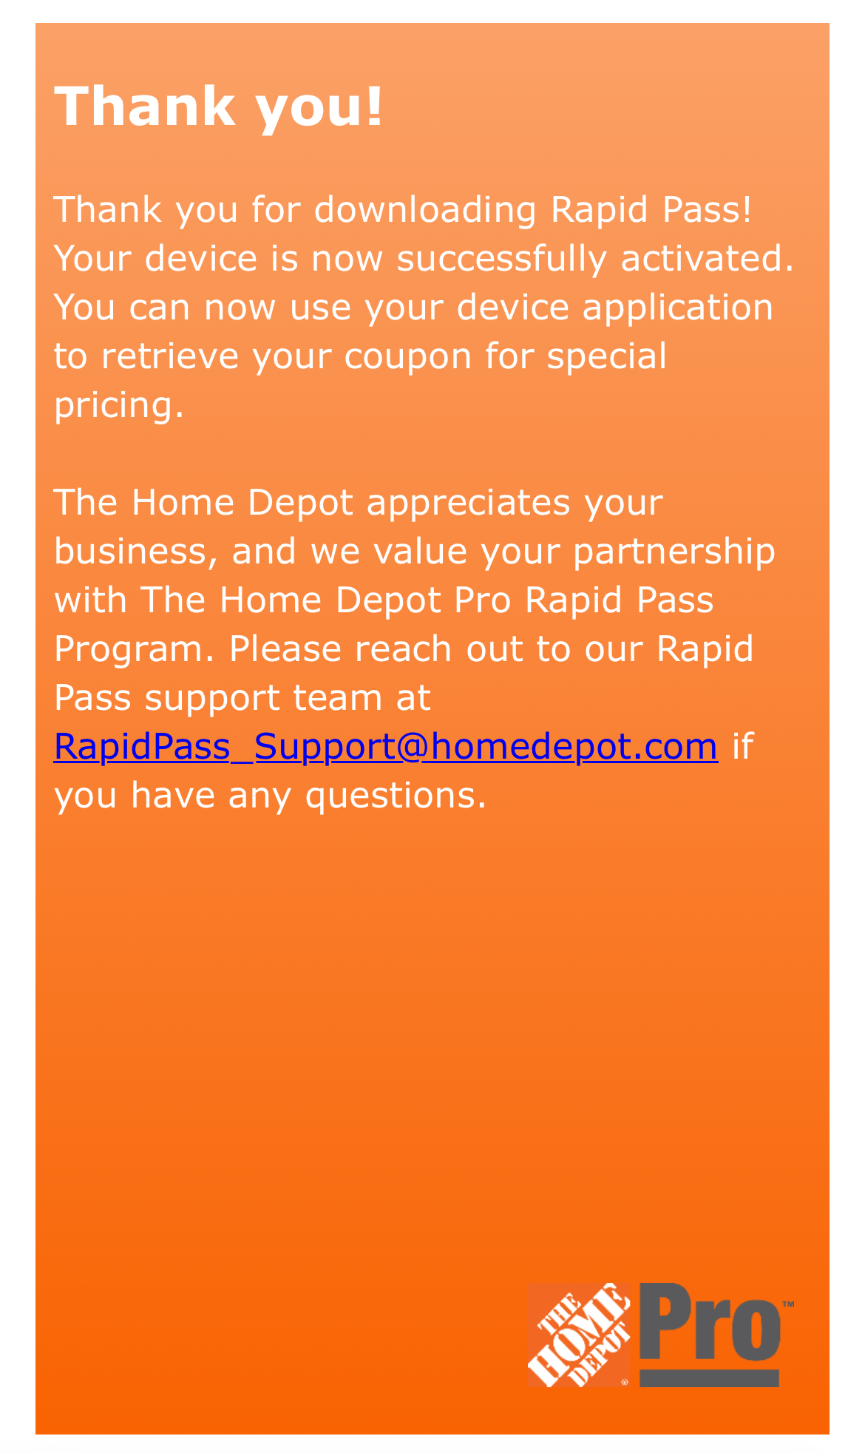
Registration & Activation of Rapid Pass
Fill out Registration page with: Your Name
Your Company name
Your phone number
Your Email then Continue
You will be sent an Activation link via email
that you provided on the registration page.
Go to that email for next step. If you don’t
receive the email, either resend
or check your email address for accuracy.
You must confirm your email address
by clicking the link within the activation
email. This link is only active for 24 hours.
If you miss this step, start over at Step 1
on this page.
Open the Rapid Pass App on your
Mobile device
You should see the Registration Page
Rapid Pass is now ready for use
Please see next page for correct
barcode/coupon generation for use
in store.
New download links are created every
quarter but this only affects new email addresses
and/or existing customers with new mobile devices.

Slide 6
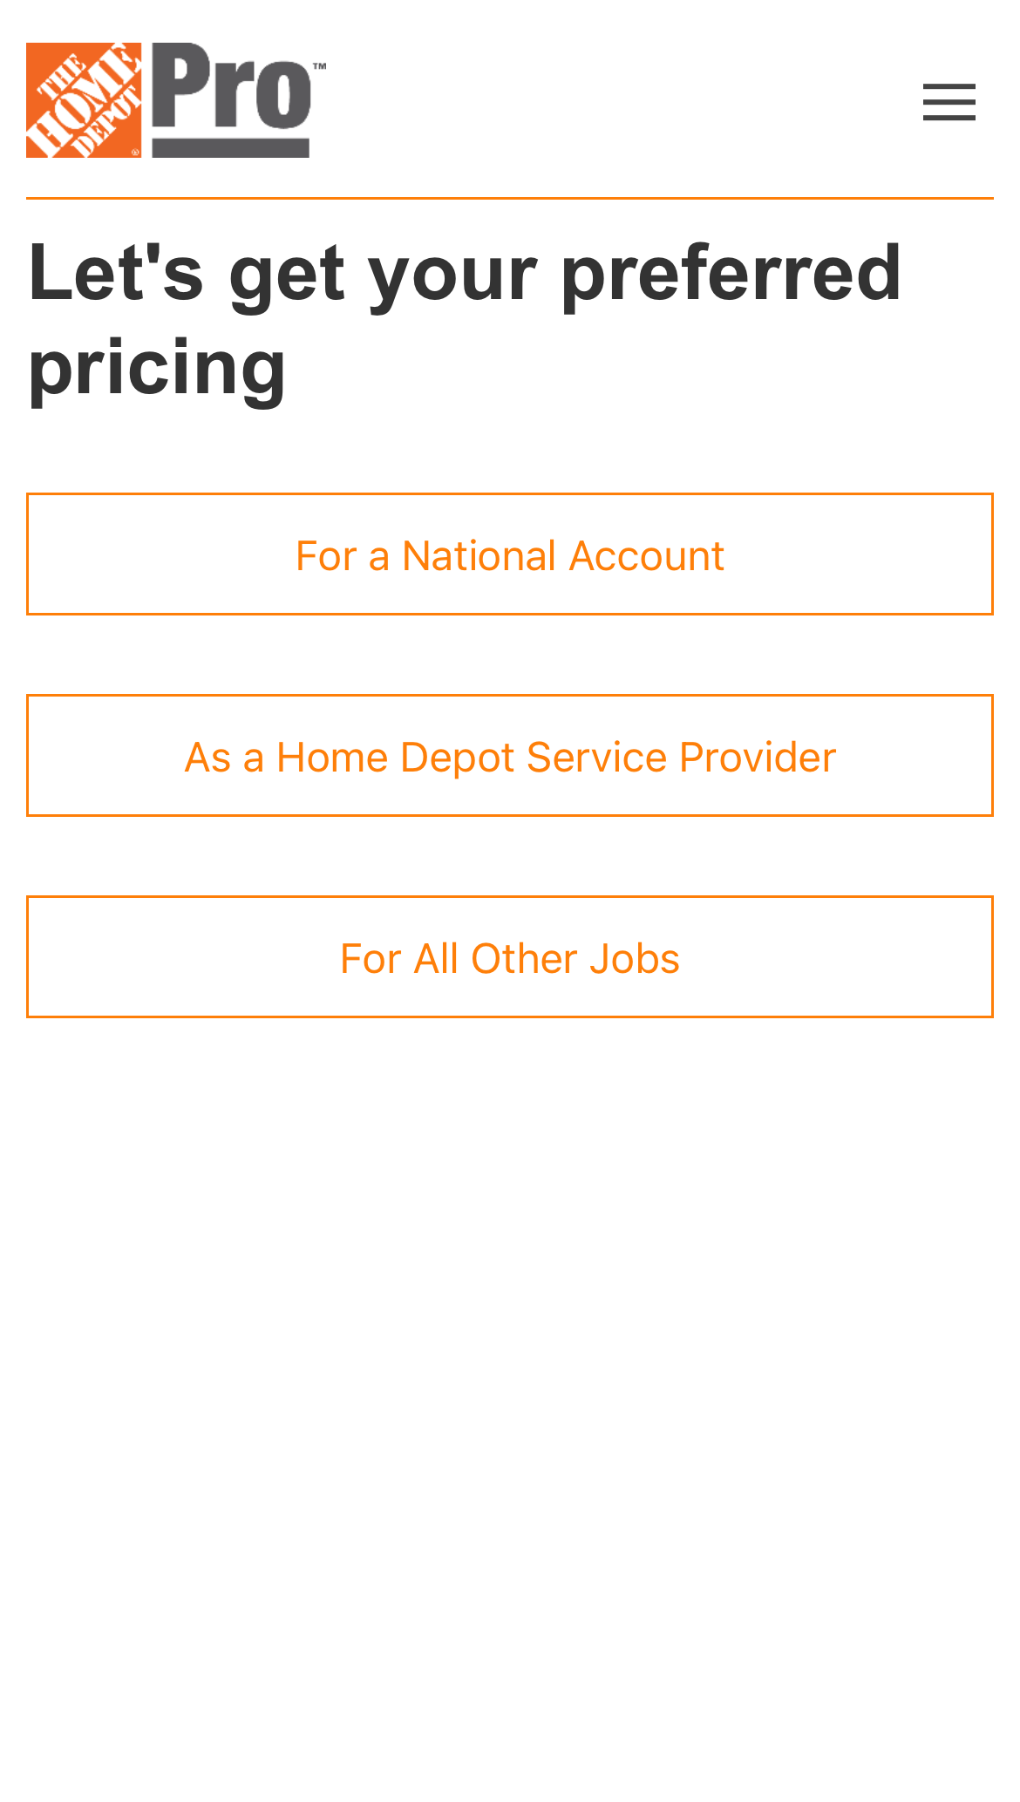
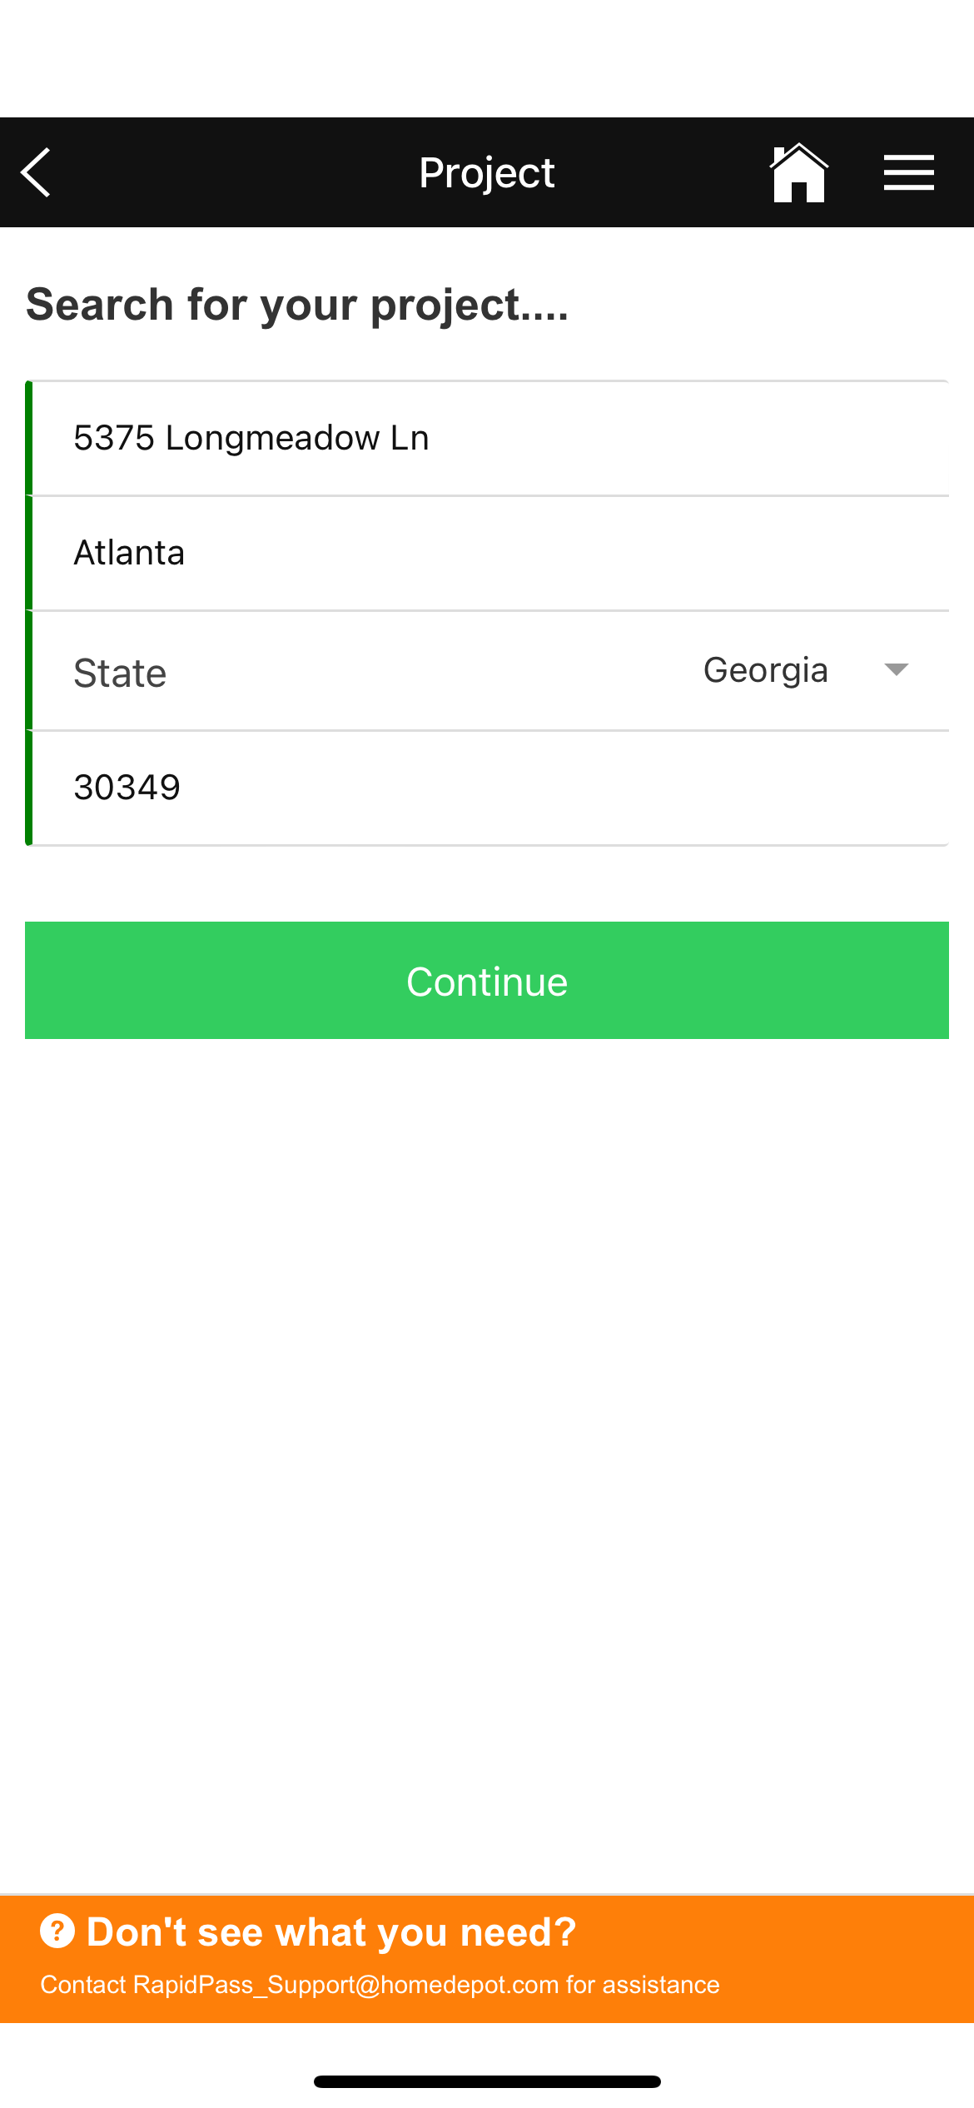
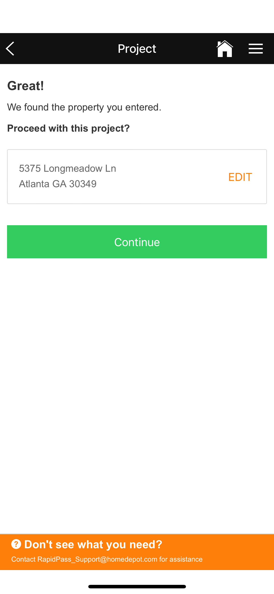
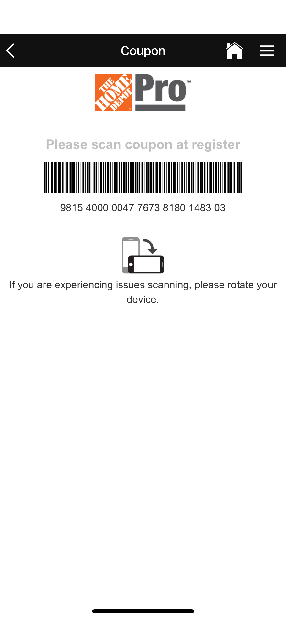
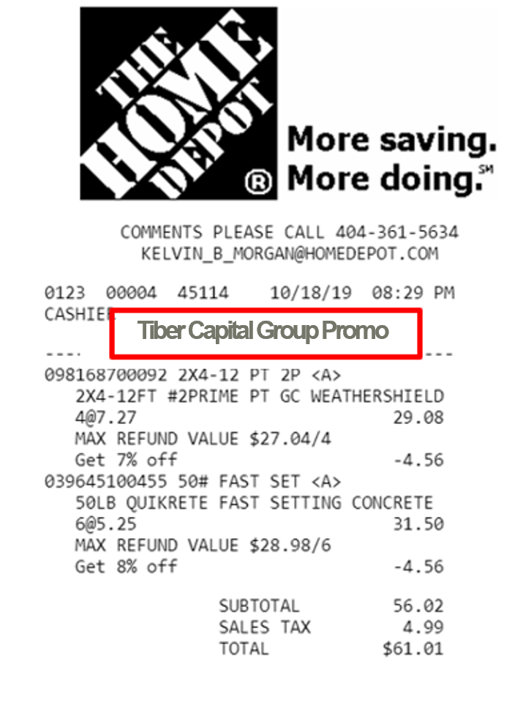
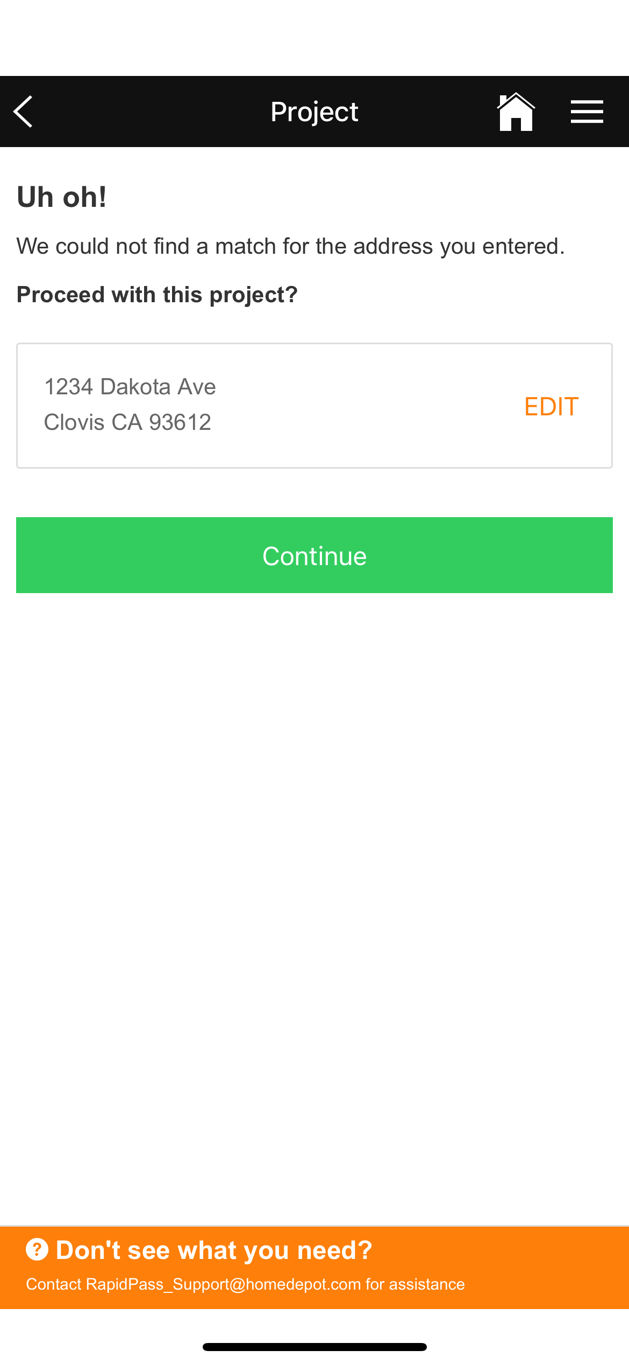
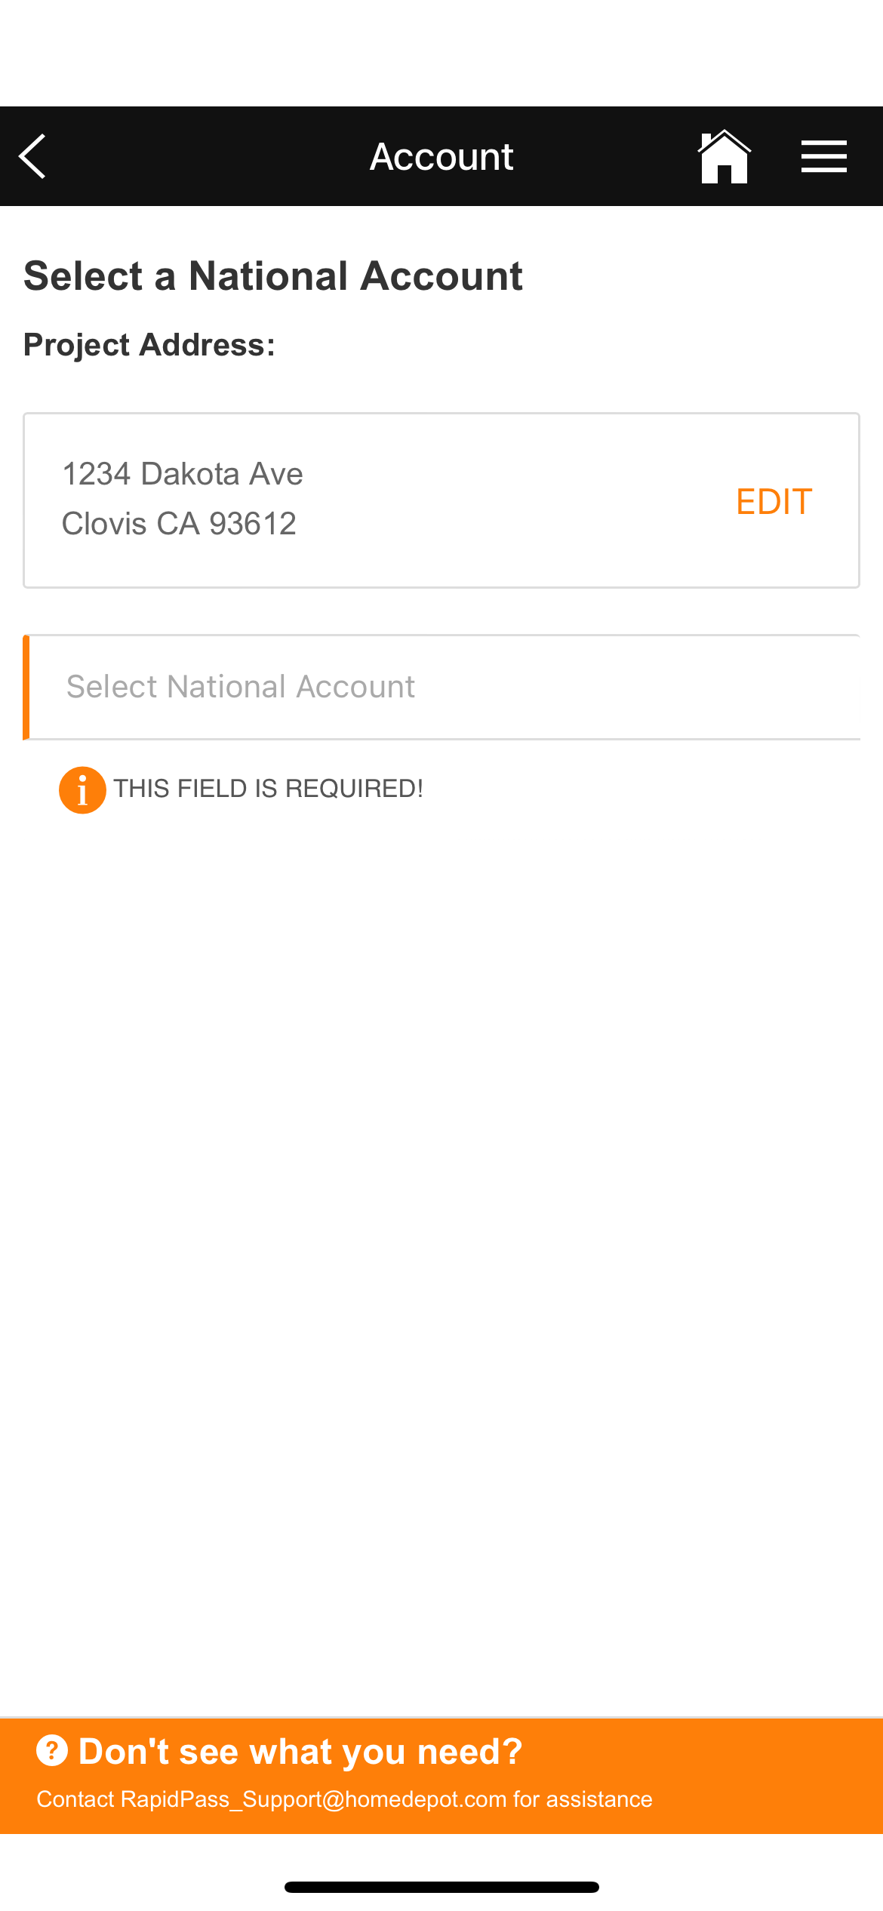
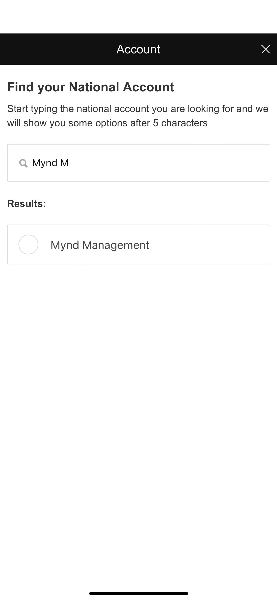
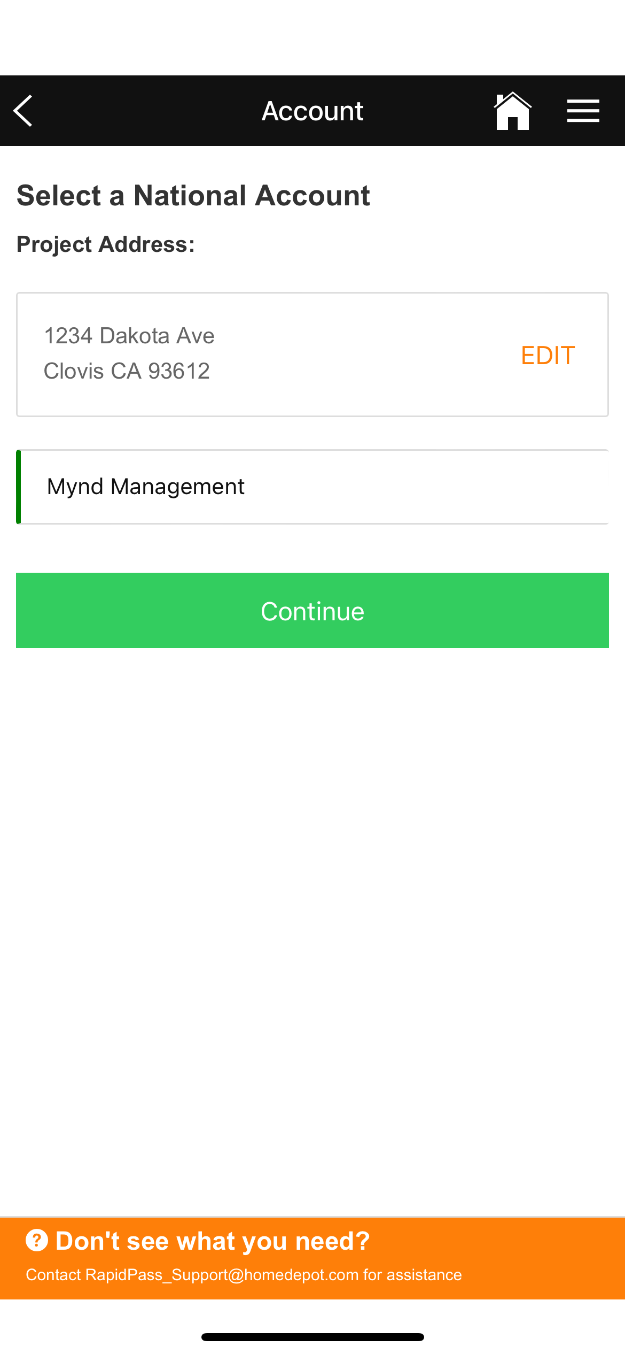
Generating a Rapid Pass Coupon Barcode
Did it work?
You should see the NA Promo
on the receipt.
Input a valid Property Address
and select Continue
Property Address Found
Select Continue
Rapid Pass Barcode generated;
ready to scan into transaction
Open the Rapid Pass App
Select For a National Account
Type in full address, city, state
select Continue
Type in National Account Name
Find the Nat. Account
you are working with
Rapid Pass Barcode generated;
ready to scan into transaction
Select Continue again
What if you get the
UH-OH Address not found
You can still generate the coupon with this process here:

Slide 7
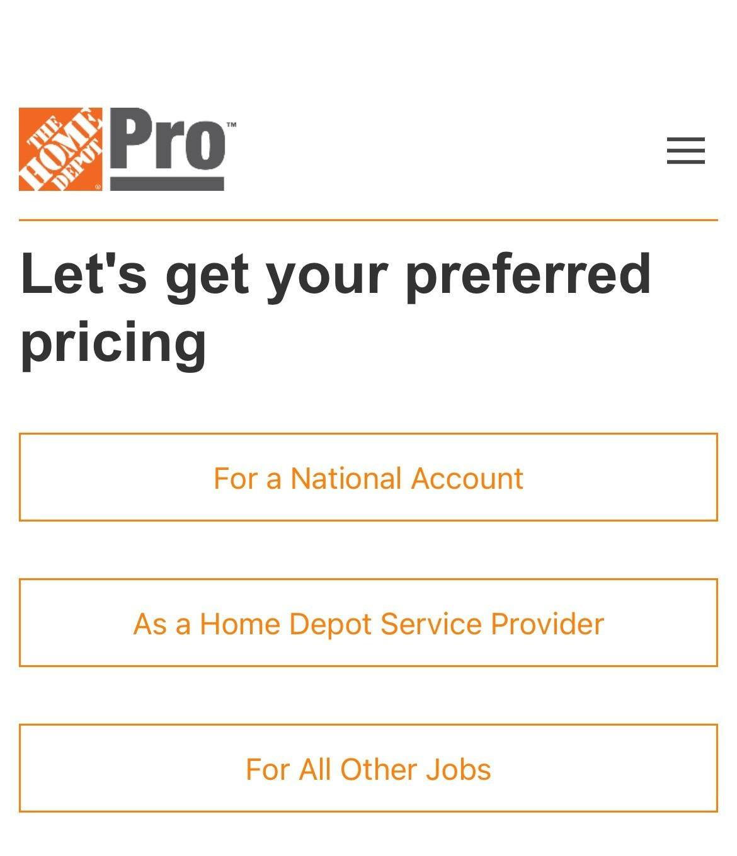
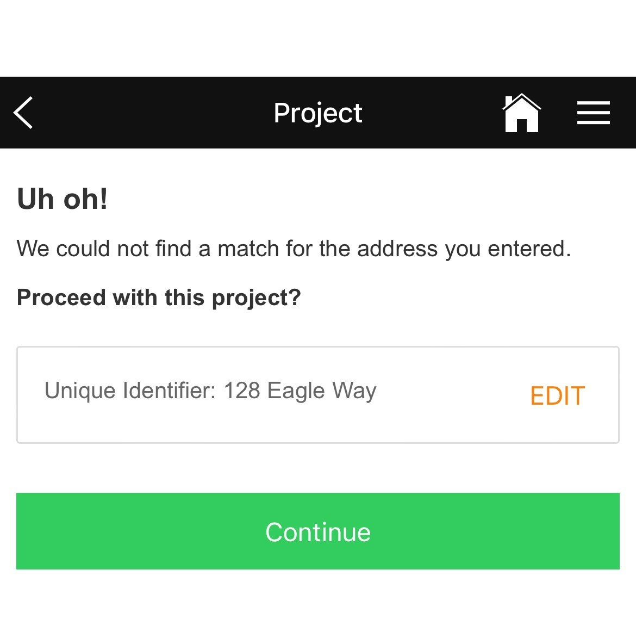
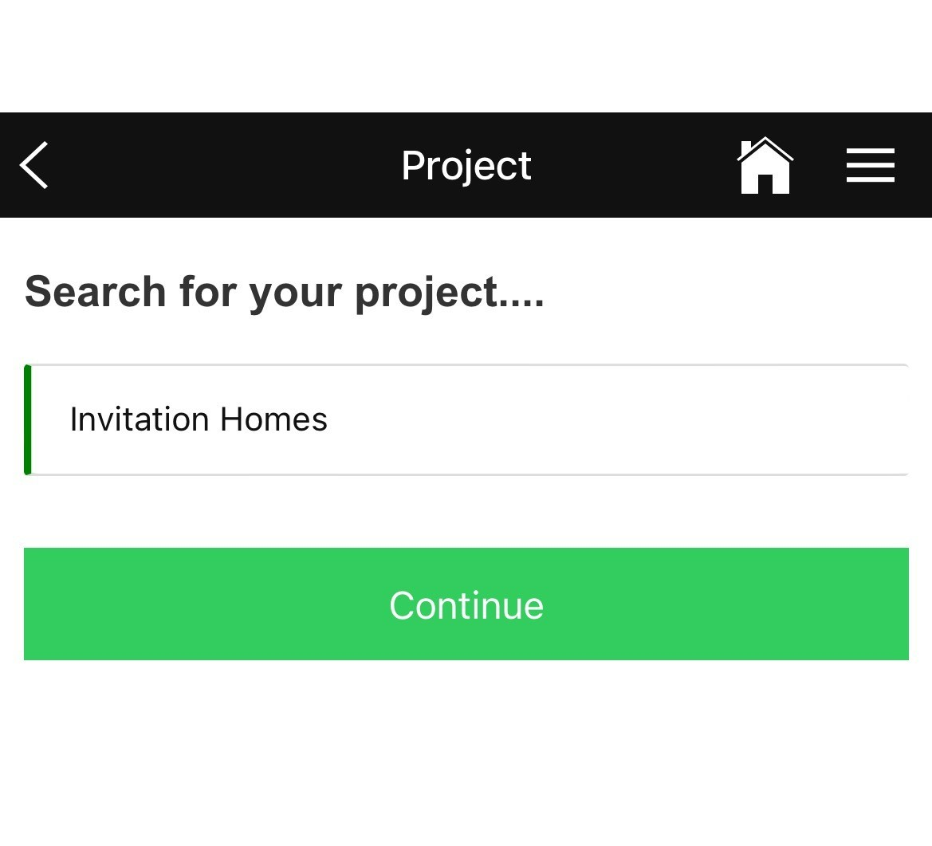
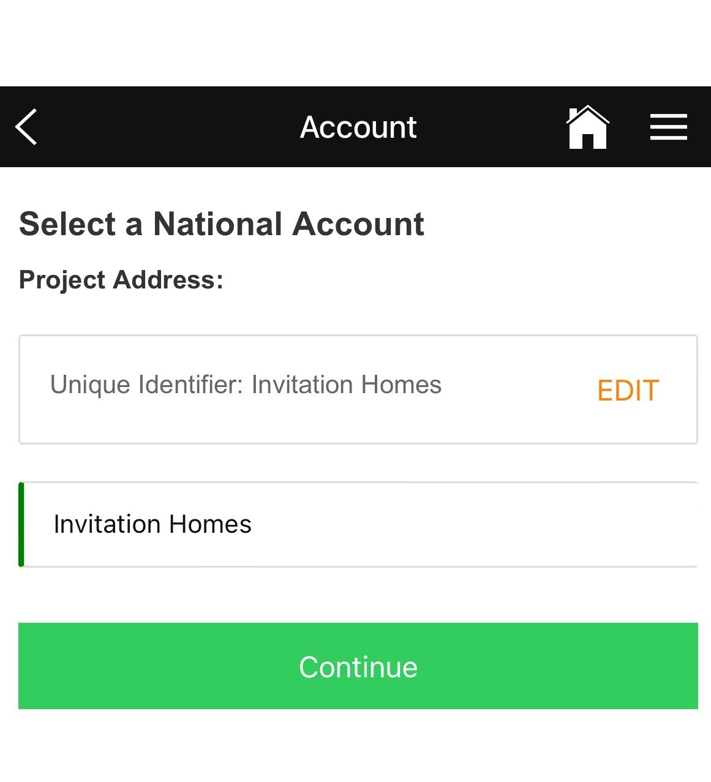
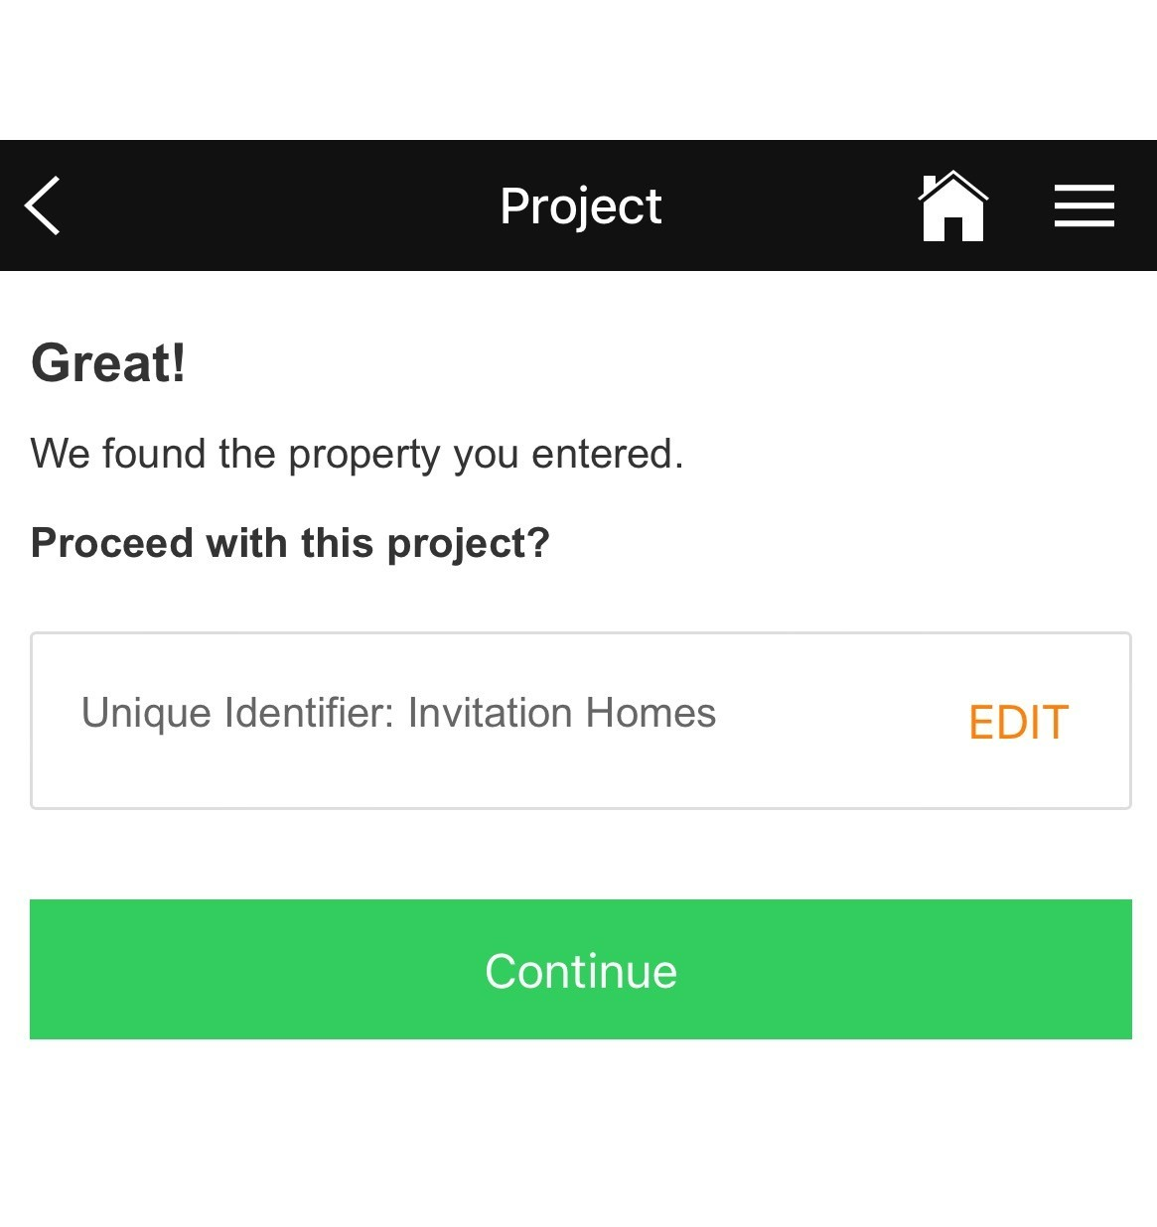
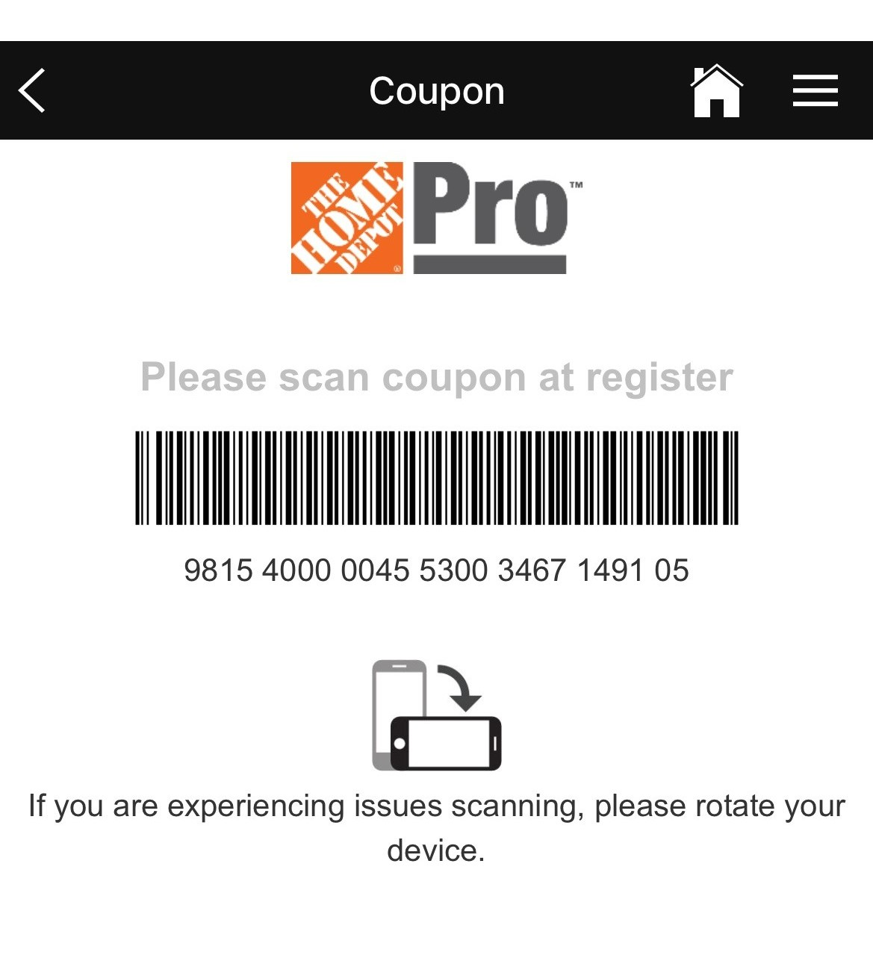
Uh-Oh scenario and solution
Always select “Continue”
if Uh-Oh! screen is visible

Slide 8
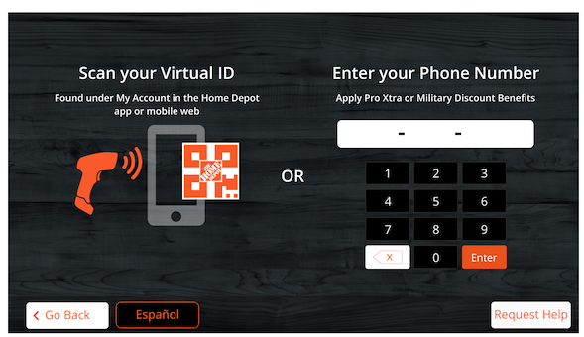
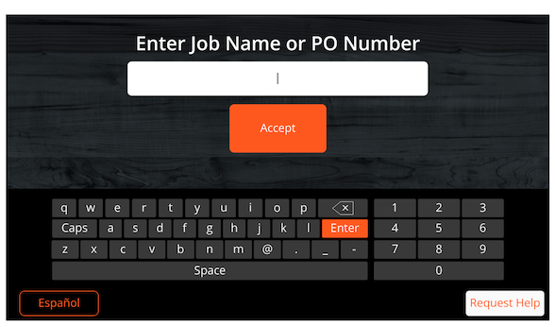
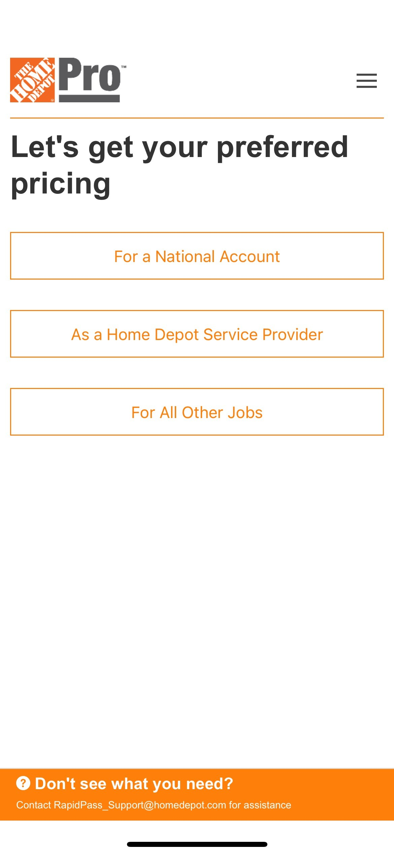
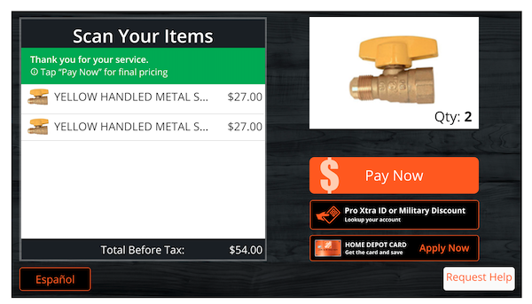
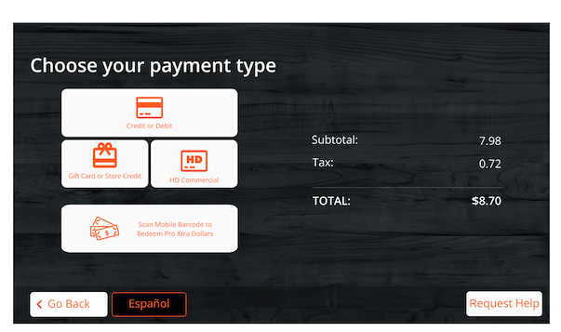
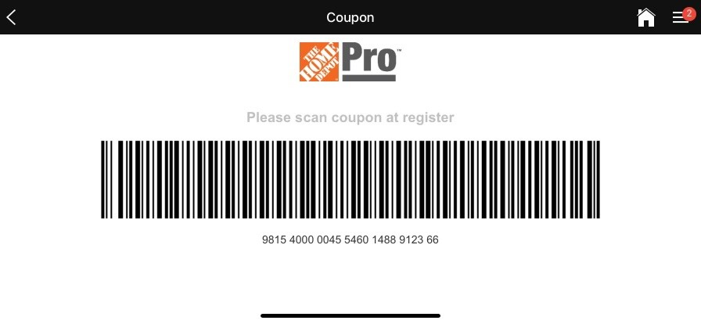
Rapid Pass Checkout on behalf of a National Account
Do not enter a ProXtra number/ID when Rapid Pass is used at register.
If ProXtra ID is input, it is possible Preferred Pricing will remove the discount applied by Rapid Pass.
Rapid Pass should be scanned during every transaction to obtain maximum discount opportunities.
Begin scanning merchandise at SCO or register;
Do not input ProXtra ID/Phone number
Pro enters Job Name/Address/PO Number field
if needed
Generate Rapid Pass Coupon
for transaction
Scan your Rapid Pass Coupon
or present to Cashier for scan
Complete transaction with a registered
tender
Receipt will show National Account name
and detailed special pricing

Slide 9
Did it work? Verify receipt
“Customer Promo” indicates that the process was followed correctly, and appropriate discounts were applied to transaction
Line-item discount shown is for total order

Slide 10
FAQ
Where can I use Rapid Pass?
Rapid Pass can be used at any Home Depot location in the United States
How long is the coupon generated by Rapid Pass good for?
After entering a property address or unique identifier, the coupon displayed can only be used one time
Can I make multiple purchases on the same property or unique identifier?
A valid client property address or unique identifier can be entered multiple times to retrieve a new coupon for each transaction
When should I use the application in the store?
Do not display a coupon until you are ready to checkout. The coupon can be scanned at any point during the transaction before final payment
Can I use the Rapid Pass coupon with other coupons?
The coupon generated from Rapid Pass is not combinable with other offers
Does Rapid Pass affect my ProXtra account?
No. Purchases made on Rapid Pass still give you credit to your ProXtra account as long as you pay with a registered tender.
If you are not transacting on behalf of a National customer, you can enter your ProXtra phone number at the register to access pricing and benefits
Can I use Rapid Pass in self-checkout?
If using application through the self-checkout line, the barcode number will need to be entered by Home Depot associate at the central kiosk at the front of the self-checkout stations. We recommend going to the Pro Desk or standard checkout line in order to scan the coupon
For more questions, email RapidPass_Support@homedepot.com

Slide 11
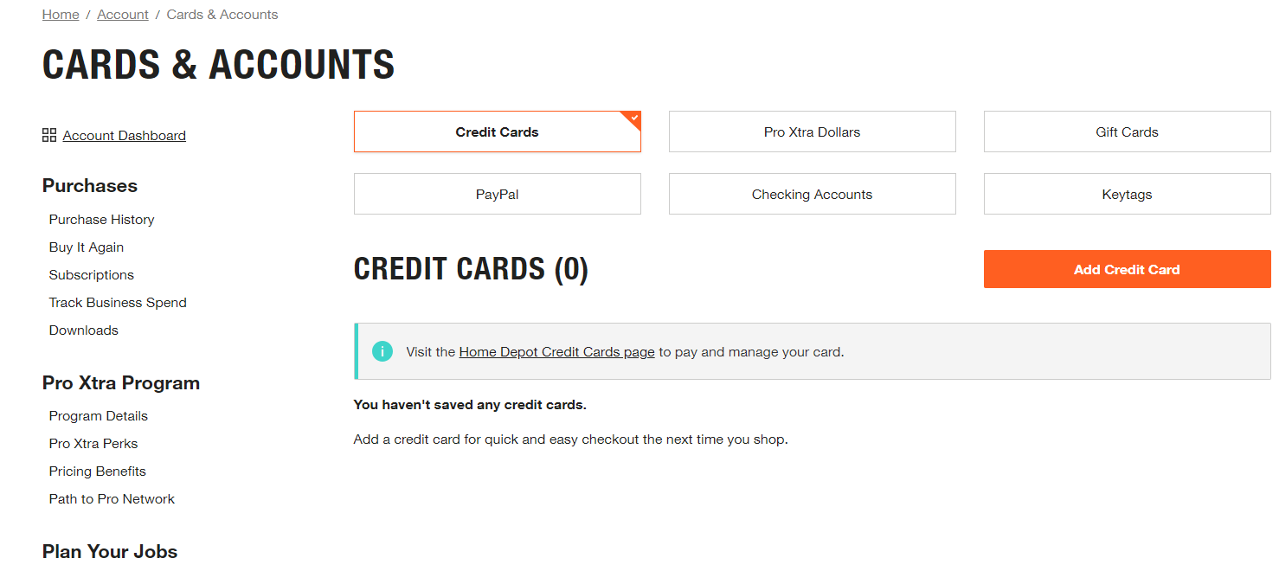
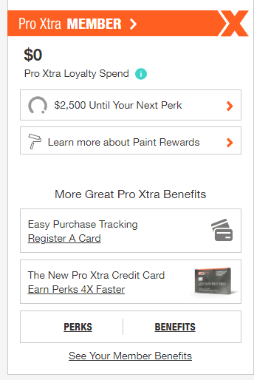
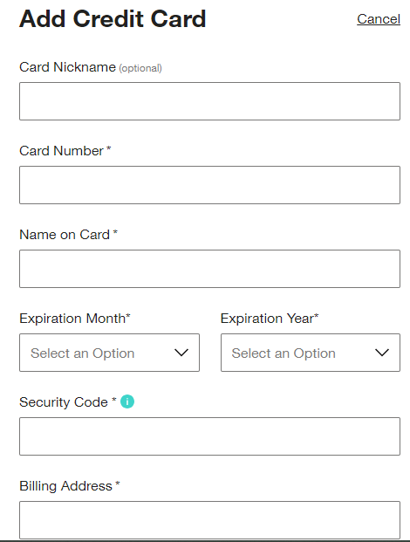
Register a Credit Card on ProXtra
https://www.homedepot.com/c/Pro_Xtra
Select Add a Card
Navigate to your ProXtra Account, Sign in or Create an Account
Navigate to Register a card on Welcome page
Select Register a card
Fill Out Information and Verify:
**Please Note: Credit cards can only be associated with one Pro Xtra account. If the card you’re adding is a payment method on another account, all purchase history information for the card will move to this account.
Card is added Successfully
All transactions tendered on registered cards will reflect
on the ProXtra account it is assigned to.

Slide 12
Contact Info:
Alaykia Sykes
Pro Business Senior Manager
(770) 331-1438
Alaykia_Sykes@homedepot.com
Lisa Barber
Pro Business Analyst
National Account Support
Lisa_H_Barber@homedepot.com
Technical Support
RapidPass_Support@homedepot.com
ProXtra Links
https://www.homedepot.com/c/pro_resource_center
How to Authorize Cards to Your Account - The Home Depot
https://www.homedepot.com/c/pro_videos

